Slide 1
ITIL® 2011 Foundation Certification Course
Unit 2—Service Strategy

Slide 2
Service Strategy
Lesson 1—Introduction to Service Strategy

Slide 3
Objectives
Describe the purpose, objective, scope and value of service strategy
Identify the four processes in service strategy
Explain the different types of services provided
After completing this lesson, you will be able to:

Slide 4




Service Strategy—Purpose
The service strategy phase provides a defined solution to a business problem.
The purpose of the service strategy phase is to define the perspective, position, plans and patterns that a service provider needs to be able to execute to meet an organisation’s business outcomes.
Purpose
Objective
Scope
Value

Slide 5

Service Strategy—Objective
The objective of the service strategy phase is as follows:
Understand the strategies and identify the services and the customers.
Define value creation and how it is delivered.
Identify opportunities to provide services.
Design a clear service provision model.
Document and coordinate how service assets are used to deliver services and how to optimise their performance.
Set up processes to define the strategy of the organisation.
Purpose
Objective
Scope
Value

Slide 6
Service Strategy—Scope
The service provider should answer the following questions to define the scope of service strategy:
What services should be offered and to whom?
How to differentiate themselves from competing alternatives?
How to create value for customers?
How to capture value for stakeholders?
The scope includes defining a strategy:
to deliver effective services to meet a customer’s business outcome; and
to manage the services provided to the customers.
Purpose
Objective
Scope
Value

Slide 7
Service Strategy—Value for Business
The service strategy phase offers value in the following manner to business:
Support the activities performed by the service provider to facilitate outcomes for customers.
Enable the service provider to understand the types and levels of service that a customer requires.
Enable the service provider to respond quickly and effectively to changes in the business environment.
Support the creation and maintenance of a portfolio of quantified services.
Facilitate functional and transparent communication between the customer and the service provider.
Purpose
Objective
Scope
Value

Slide 8

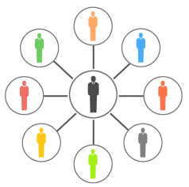


Service Strategy Processes
The processes in service strategy include:
Demand Management
Service Portfolio Management
Financial Management
Business Relationship Management
It is the process of understanding the demands for services.
It refers to the complete set of services offered by a service provider.
It provides an understanding of opportunities associated with services in financial terms.
It ensures that the service provider understands the changing needs of the customer.

Slide 9

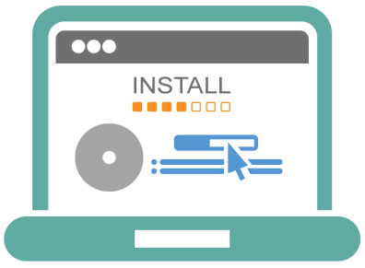

Types of Services
Services are classified based on the customer's requirement and the service provider's capabilities. The services are classified into:
Core Services
Enabling Services
Enhancing Services
Provide the basic results that a customer desires.
Anchor the value proposition for the customer.
Serve as basic factors enabling the customer to receive the core service.
These are services added to a core service to make it more attractive to the customer.

Slide 10
Types of Services
An example of core services, enabling services, and enhancing services is given below:
 | Core services | Enabling services | Enhancing services
IT services (benefits tracking) | Employee of a company can monitor the status of their benefit, that is, health insurance | A portal that provides a user with front-end access to the benefits tracking service | Customers can create and manage a fitness or weight loss programme

Slide 11
Service Strategy—Customers and Users
Customers and users are defined as follows:
Customers are the ones who pay for services. They negotiate and agree to service level targets with service providers. Sometimes the customers also can be users.
Users are those who use the services on a day-to-day basis.

Slide 12
Which service is needed to deliver a core service?
Enhancing service
Enabling service
Internal service
External service

Slide 13
Which service is needed to deliver a core service?
Enhancing service
Enabling service
Internal service
External service
Answer: b.
Explanation: Enabling services help to deliver a core service to customers.

Slide 14
Summary
The service strategy phase provides a defined solution to a business problem.
Demand Management, Service Portfolio Management, Financial Management and Business Relationship Management are the processes in service strategy.
Services are classified into core services, enabling services and enhancing services.
Here is a quick recap of what we have learnt in this lesson:

Slide 15
Service Strategy
Lesson 2—Service Strategy Concepts

Slide 16
Objectives
Describe the basics of value creation through services
Explain business case
After completing this lesson, you will be able to:

Slide 17
Service Utility and Warranty
The two key elements that combine to provide service value are utility and warranty.
Utility | Warranty
Functionality offered by product or service from the customer perspective | Promise that the product or service will meet agreed requirements
What the customer gets | How service is delivered
Fit for purpose | Fit for use: Three characteristics of warranty: Provided in terms of availability/capacity of services Makes sure that customer assets continue to receive utility, even if degraded, through major disruptions Ensures security for value-creating potential of customer assets
Increases performance average | Reduces performance variation

Slide 18
Service Utility and Warranty (contd.)
The image illustrates how the two key elements combine to create value in IT Services.
Performance supported?
Fit for Purpose?
OR
Constraints removed?
Utility
Enough availability?
Value
Enough capacity?
AND
Continuous enough?
Fit for Use?
Warranty
Secure enough?
© Crown Copyright 2011. Reproduced under licence from AXELOS.

Slide 19
Service Assets
Utility of a service is delivered through service assets. Service assets include resources and capabilities.
Resources | Capabilities
Tangible assets of an organisation | Intangible assets of the organisation
Can be purchased | Cannot be purchased
Direct inputs for the production of goods | Ability to co-ordinate, control and deploy resources
IT infrastructure, people, applications | Management, people, process and knowledge

Slide 20
Service Assets (contd.)
The nine service assets are mentioned below:
Resources | Capabilities
Financial capital | Management
Infrastructure | Organisation
Applications | Processes
Information | Knowledge
People

Slide 21
The utility of a service can be described as:
Fit for use
Fit for design
Fit for function
Fit for purpose

Slide 22
The utility of a service can be described as:
Fit for use
Fit for design
Fit for function
Fit for purpose
Answer: d.
Explanation: The utility of a service can be described as fit for purpose.

Slide 23

Value Creation
Values are defined by the customers. A service should have an affordable and best mix of features.
Value changes over time and circumstances.
Value needs to be defined in terms of business outcomes, customer’s preferences and customer’s perception.

Slide 24

Value Creation (contd.)
To understand the value of IT, the following questions need to be answered :
What services does IT provide?
What did the services achieve?
What is the cost of a particular service?

Slide 25
Factors that Influence Customer Perception of Value
Value from the customer perception is influenced by:
service features;
present or past experiences;
self-image;
peers; and
position in the market.

Slide 26
Customer Perception of Value
Customer point is the reference value and is based on Do It Yourself or DIY strategy.
Positive
difference
Negative
difference
Losses from
utilising the
service
_
Gains from
utilising the
service
+
Net
difference
Based on DIY strategy or
existing arrangements
Reference
value
Economic value
of service
© Crown Copyright 2011. Reproduced under licence from AXELOS.

Slide 27
Business Outcomes
Service management uses its service assets to deliver a service that meets the business outcomes of the customer.
Service Management
Service Assets
Business Outcomes
It is a set of organisational capabilities specialised in providing value to customers in the form of services.
Service assets are the source of value and customer assets are the recipients. Service assets perform based on customers’ needs.
Service management enables the service assets to achieve desired business outcomes.

Slide 28
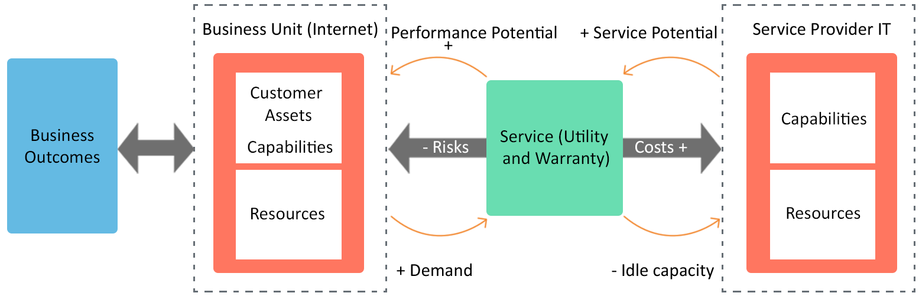
Business Outcomes (contd.)
The image on the screen illustrates the relationship between the service provider, the business unit and the customer’s business outcomes.
© Crown Copyright 2011. Reproduced under licence from AXELOS.

Slide 29



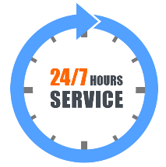
Service Packages
Each IT service provider will have multiple customers with different needs and requirements. Through service packages, service providers meet their customer requirements.
Example: Support to email service is offered as two different service level packages—one where the service is required only during office hours and another where it is needed 24/7 because of more users.
Email Service
Support to email service is used only during office hours
Support to email service is used 24 hours a day

Slide 30
Service Packages (contd.)
A service package provides a detailed description of a package of bundled services available to be delivered to customers. It defines the level of utility and warranty provided by the service package. The content of a service package includes:
Service package
Core services
Enabling services
Enhancing services
Service level packages
Availability Levels
Capacity Levels
Security Levels
Continuity
Service Features
Service Support
© Crown Copyright 2011. Reproduced under licence from AXELOS.

Slide 31
Business Case and Its Uses
A business case is a documented justification that demonstrates that by adding a new service, the service provider can attract many new customers. It helps to evaluate the business viability of providing a new service.
Following are the uses of a business case:
It is a decision support and planning tool.
It provides justification for a significant item of expenditure.
It includes a report that focuses on benefits, issues, risks and possible problems.

Slide 32
Business Case Structure
A business case structure includes:
an introduction;
methods and assumptions;
business impacts;
recommendations;
risks; and
contingencies.

Slide 33

Risk
Risk is defined as uncertainty that can have a positive or negative outcome.
If the outcome of a risk is positive, the risk is called an opportunity.
If the outcome of a risk is negative, the risk is called a threat.
Risk analysis is gathering information about risk exposure.
A risk is a possible event that could cause harm or loss, or affect the ability to achieve objectives.
!
The aim of risk management is to reduce the impact of a negative outcome and increase the impact of a positive outcome.

Slide 34
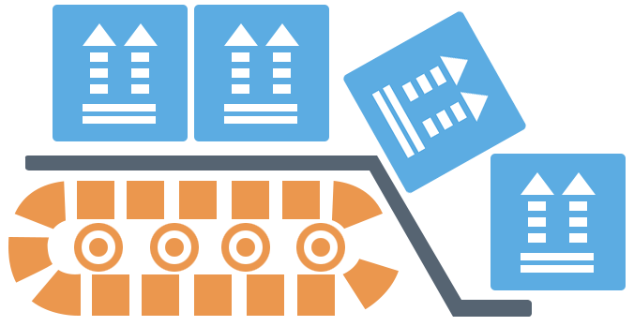
Service Management Technology and Automation
Automation can have significant impact on the performance of service assets such as management, organisation, people, process, knowledge and information. Automation:
provides real-time and historical data for analysis.
correlates data from multiple devices.
analyses service impact for prioritisation of incidents, problems and change tickets.
optimises service performance.

Slide 35
Automation Benefits
The automation of service processes improve the quality of service, reduce costs and reduce risks by reducing complexity and uncertainty, and by efficiently resolving trade-offs. The benefits include:
Design and modelling
Pattern recognition and analysis
Detection and monitoring
Service catalogue and optimisation
Classification, prioritisation and routing

Slide 36
Service Management Tools
The service management tools include the following:
Service desk self-help: Offers a menu-driven range of self-help and service requests.
Workflow or process engine: Allows responsibilities, activities, timescales, escalation paths, etc. to be pre-defined and then automatically managed.
Configuration Management System (CMS): Stores Configuration Items (CIs), records related to incidents, problems and Known Errors (KE).
Discovery and deployment: Assists in license management and deployment of new software at target locations.
Remote control: Allows relevant support groups to take control of the user desktops.

Slide 37
Summary
Utility and warranty are the two components of service value.
Service assets deliver utility of a service and include resources and capabilities.
A service package provides a detailed description of a package of bundled services available for customers.
A business case is used as a decision support and planning tool that projects the likely consequences of a business action.
Here is a quick recap of what we have learnt in this lesson:

Slide 38
Service Strategy
Lesson 3—Service Strategy Processes

Slide 39
Objectives
Describe the purpose and objective of the different processes in service strategy
Describe the activities involved in Service Portfolio Management (SPM) and financial management for IT services
Identify the responsibilities of the Business Relationship Manager
After completing this lesson, you will be able to:

Slide 40


Demand Management—Purpose
Demand management is the process of understanding the demands for services and managing them to help customers achieve their business objectives.
The purpose of demand management is as follows:
Understand and influence customer demand for services.
Work with the capacity management to ensure the service provider has capacity to meet its demand.
Purpose
Objective
Scope

Slide 41
Demand Management—Objective
The objective of demand management is as follows:
Identify and analyse Patterns of Business Activity (PBA) and User Profiles (UP).
Anticipate and prevent or manage the situations where the demand for a service exceeds the capacity.
Gear the utilisation of resources that deliver services to meet the fluctuating levels of demand for the services.
Purpose
Objective
Scope

Slide 42
Demand Management—Scope
The scope of demand management is as follows:
Identify and analyse the PBA that initiates demand for services.
Identify and analyse how different types of users influence the demand for services.
Purpose
Objective
Scope

Slide 43
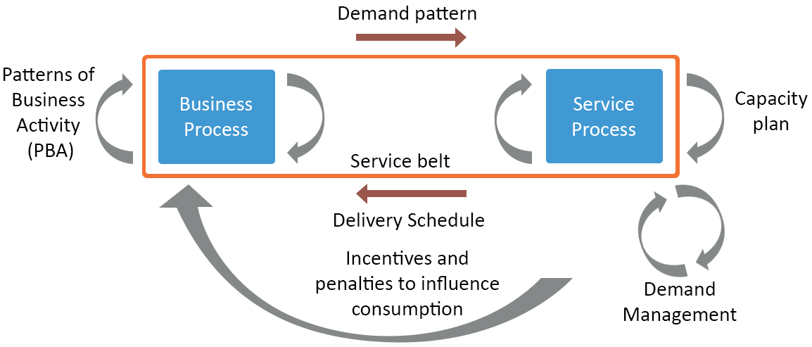
Managing Demand for Services
The primary source of demand for IT services comes from the execution of business process within the organisations.
© Crown Copyright 2011. Reproduced under licence from AXELOS.

Slide 44


PBA and UP
PBA and UP (User Profile) play a vital role in designing the service strategy.
UP
PBA
Pattern of user demand for IT services
Each user profile includes one or more PBAs
Workload profile of one or more business activities
Varies over time
Represents changing business demands

Slide 45


PBA and UP (contd.)
PBA defines the dynamics of a business and includes interactions with customers, suppliers, partners and other stakeholders.
PBA changes with improvements in business, process, people, organisation and so on.
UPs are based on roles and responsibilities within an organisation.
PBA
(Downloading during night)
Internet Service Provider
User Profile (16 to 20 years)
!
PBA and UP ensure a systematic approach to understand and manage demand of the customers.

Slide 46
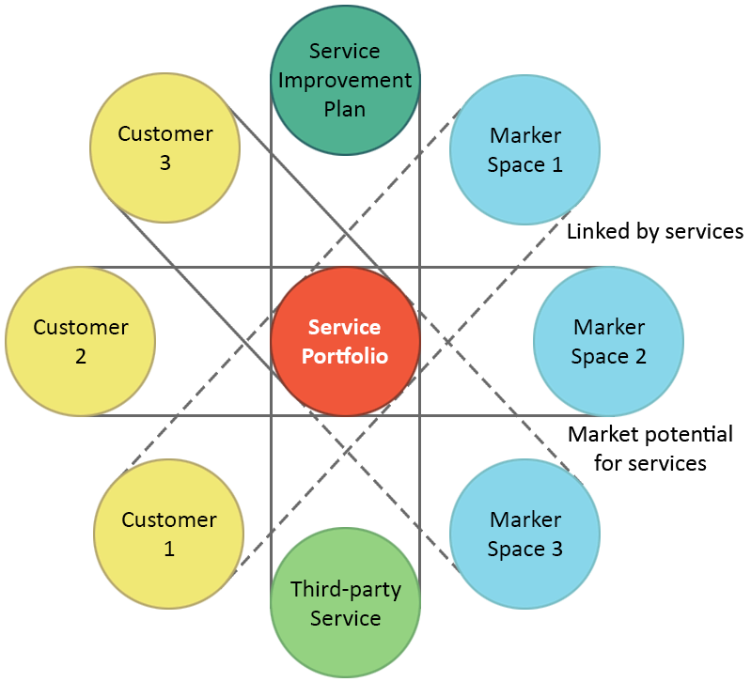
Service Portfolio Management—Introduction
The Service Portfolio Management (SPM) refers to the complete set of services offered by a service provider under management across all customers and market spaces.
The image depicts the grouping between customers and the service portfolio, supported by an understanding of the market space.
© Crown Copyright 2011. Reproduced under licence from AXELOS.

Slide 47
Service Portfolio Management—Purpose
SPM represents the ability and readiness of a service provider to serve customers and market spaces.
The purpose of SPM is as follows:
Ensure the service provider has the right mix of services to balance the investment in IT with the ability to meet business outcomes.
Track the investment in services throughout their lifecycle.
Ensure services are clearly defined and linked to the achievement of business outcomes.
Purpose
Objective
Scope

Slide 48
Service Portfolio Management—Objective
The objective of SPM is as follows:
Provide process and mechanisms to enable an organisation to investigate and decide the services to offer.
Maintain the definitive portfolio of services provided.
Provide a mechanism for the organisation to evaluate how services achieve its strategy.
Control the services offered in specific conditions and the level of investment.
Analyse the services that are no longer viable.
Purpose
Objective
Scope

Slide 49
Service Portfolio Management—Scope
The scope of SPM is as follows:
Maintain accurate information on all services that are planned to be delivered, currently delivered or have been withdrawn.
Evaluate the value of services throughout their lifecycle.
Purpose
Objective
Scope

Slide 50
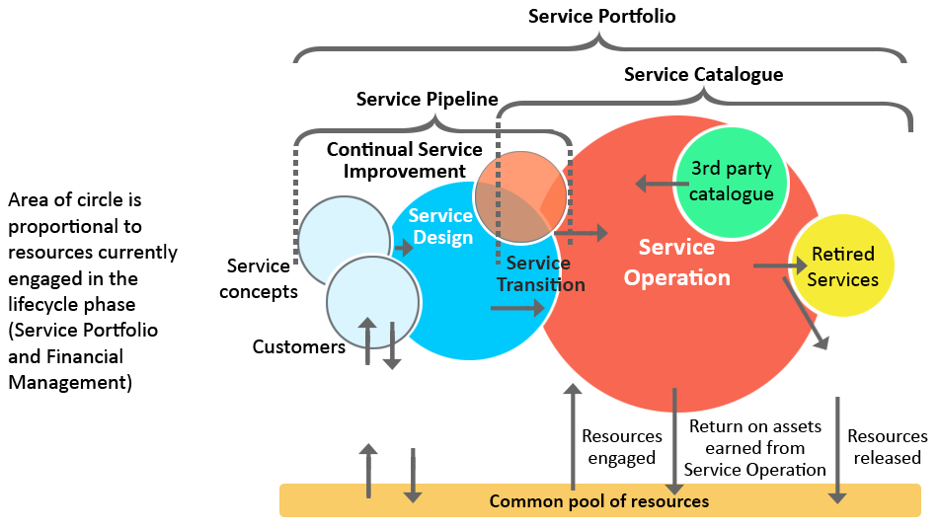
Service Portfolio—Components
The components of service portfolio are service pipeline, service catalogue and retired services. The image illustrates how these components contribute to services offered by the service providers to the customers.
© Crown Copyright 2011. Reproduced under licence from AXELOS.

Slide 51
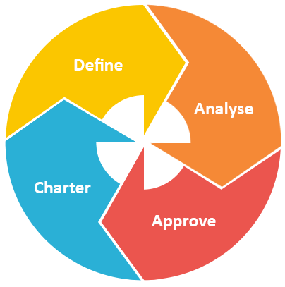
Service Portfolio Management—Process
SPM consists of four main phases of activity. It is a dynamic and on-going process set. The image represents the activities that take place in each process.
Involves activities like making inventory services, documenting business cases and validating portfolio data.
Involves maximising portfolio value, aligning, prioritising and balancing supply and demand.
Involves communicating decisions, allocating resources and chartering services.
Includes finalising proposed portfolio and authorising services and resources.

Slide 52
Financial Management—Purpose
Financial management provides an understanding of opportunities associated with services in financial terms.
The purpose of financial management for IT service process is as follows:
Secure the sufficient level of funding to design, develop and deliver services.
Ensure that the service provider does not commit to services that cannot be provided.
Identify the balance between cost and quality of service, and maintain the balance of supply and demand between the service providers and their customers.
Purpose
Objective
Scope

Slide 53
Financial Management—Objective
The objective of financial management for IT service process is as follows:
Define and maintain a framework to identify, manage and communicate the cost of services offered.
Assess the financial impact of new or changed strategies on the service provider.
Execute the financial policies and practices in the provision of the services.
Engage in accounting for money spent on the creation, delivery and support of services.
Purpose
Objective
Scope

Slide 54
Financial Management—Scope
The scope of financial management for IT service process is to set:
financial policies;
budgeting procedures;
financial reporting standards;
accounting practices; and
revenue generation or cost recovery rules.
Purpose
Objective
Scope

Slide 55

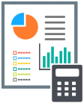

Financial Management—Activities
The three fundamental activities related to financial management of IT services are:
Budgeting:
Forecasts the requirements for funds to deliver the agreed upon services.
Monitors adherence to the defined budgets.
Accounting:
Enables the IT accounting team to track the money spent.
Identifies costs by customer, by service, by activity or other logical groupings.
Charging customers:
Establishes pricing policy.
Requires sound IT accounting practices.

Slide 56
Financial Management—Benefits
Financial management is a well-established and well-understood part of an organisation. The benefits are as follows:
Enhanced decision making and increased speed of change
Improved SPM and operation control
Financial compliance and control
Greater insight and communication of the value created
Increased visibility of IT leading to increased perception of IT

Slide 57
Which of the following establishes a pricing policy for customers against the services delivered?
Budgeting
Charging
Accounting
Cataloguing

Slide 58
Which of the following establishes a pricing policy for customers against the services delivered?
Budgeting
Charging
Accounting
Cataloguing
Answer: b.
Explanation: Charging establishes a pricing policy for customers against the services delivered.
Notes:
<The right answer must come up on clicking any option>
<Next slide AS is played>
Next, we will focus on the purpose, objective and scope of business relationship management.

Slide 59
Business Relationship Management—Purpose
Business Relationship Management (BRM) process ensures that the service provider understands the changing needs of the customer and assists the business in articulating the value of a service.
The purpose of the BRM process is as follows:
Establish and maintain a business relationship between the service provider and the customer.
Identify customer needs and ensure that the service provider meets these needs.
Purpose
Objective
Scope

Slide 60
Business Relationship Management—Objective
The objective of BRM is as follows:
Ensure the service provider understands the customer’s perspective of service.
Establish and maintain a constructive relationship between the service provider and the customer.
Identify changes to the customer environment.
Establish and articulate business requirements for new services or changes to existing services.
Establish formal complaints and escalation processes for the customer.
Purpose
Objective
Scope

Slide 61
Business Relationship Management—Scope
The scope includes understanding and communicating:
business outcomes that the customer wants to achieve.
services that are currently offered to the customer.
technology trends that could impact current services and the customer, and the nature of the potential impact.
levels of customer satisfaction, and what action plans are put in place to deal with the causes of dissatisfaction.
ways to optimise services for the future.
Purpose
Objective
Scope

Slide 62
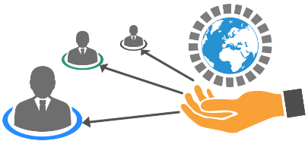

BRM—External and Internal Service Providers
The two main activities of BRM are being the voice of the service provider to the customer and vice versa.
External Service Providers
Internal Service Providers
BRM is executed by a separate and dedicated function of BRMs or account managers – each one dedicated to a customer.
BRM is executed between a senior representative from IT and senior managers from the business units.

Slide 63

Business Relationship Manager—Responsibilities
Following are the responsibilities of the Business Relationship Manager:
Documents customer complaints and instigates corrective action.
Maintains the relationship with customers and acts as a representative for the customer and the service provider.
Assists the Service Level Manager in creating a seamless conduit from customer to service provider.
Works with other service management processes and functions for information gathering.

Slide 64
Summary
Demand management helps to understand the demands for services and manage them to help customers achieve their business objectives.
Service Portfolio Management refers to the complete set of services offered by a service provider under management across all customers and market spaces.
Financial management provides an understanding of opportunities associated with services in financial terms.
The Business Relationship Manager documents customer complaints and instigates corrective action.
Here is a quick recap of what we have learnt in this lesson

Slide 66
Which ITIL® process is responsible for drawing up a charging system?
1
Availability Management
Capacity Management
Financial Management for IT Services
Service Level Management

Slide 67
Which ITIL® process is responsible for drawing up a charging system?
1
Availability Management
Capacity Management
Financial Management for IT Services
Service Level Management
Answer: c.
Explanation: Financial Management for IT Services is responsible for drawing up a charging system.

Slide 68
A Service Level Package is best described as ________.
2
A description of customer requirements used to negotiate a service level agreement
A defined level of utility and warranty associated with a core service package
A description of the value that the customer wants and for which they are willing to pay
A document showing the service levels achieved during an agreed reporting period

Slide 69
A Service Level Package is best described as ________.
2
A description of customer requirements used to negotiate a service level agreement
A defined level of utility and warranty associated with a core service package
A description of the value that the customer wants and for which they are willing to pay
A document showing the service levels achieved during an agreed reporting period
Answer: b.
Explanation: SLP consists of agreed utility and warranty which are associated with a core service package.

Slide 70
A service package includes _________.
3
Base service package, supporting service package, service level package
Core service package, supporting process package, service level package
Core service package, base service package, service support package
Core service package, supporting service package, service level package

Slide 71
A service package includes _________.
3
Base service package, supporting service package, service level package
Core service package, supporting process package, service level package
Core service package, base service package, service support package
Core service package, supporting service package, service level package
Answer: d.
Explanation: A service package includes a core service package, supporting service package and service level package.

Slide 72
ITIL® is a registered trade mark of AXELOS Limited
IT Infrastructure Library is a registered trade mark of AXELOS Limited
AXELOS® is a trade mark of AXELOS Limited

